Slide 1
Software Engineering
Topic 1:
Software Engineering: A Preview
Your Name: ____________________
Computer Science & Engineering Department
The Chinese University of Hong Kong

Slide 2
What Is Software Engineering?
Software Engineering: the “multi-person construction of multi-version software.”
  A term invented in the late 1960s.
  Not just programming.
  Dealing with complex systems
  It is part of __System Engineering__
  Standard techniques and tools are invented and applied in this field.
Notes:
Software engineering is the field of computer science that deals with the building of software systems that are so large or so complex that they are built by a team or teams of engineers. Usually, these systems exist in multiple versions and are in service for many years. During their lifetime, they undergo many changes: to fix defects, to enhance existing features, to add new features, to remove old features, or to be adapted to run in a new environment.
Parnas in 1978 defined software engineering as the “multi-person construction of multi-version software.”
Indeed, the term "software engineering" was invented in the late.1960s after the realization that all the lessons learned about how to program well were not helping to build better software systems.
In classic engineering disciplines, the engineer has tools and mathematical training to specify the properties of the product separately from those of the design. For example, an electrical engineer relies on mathematical equations to verify that a design will not violate power requirements.

Slide 3
Why Software Engineering?
Growing software scale and cost
  An order of magnitude growth in every 10 years.
  Techniques applicable to small systems could not be scaled up.
Complexity of applications
  The demand for software operations increases at a faster rate than software engineer’s productivity
Notes:
We give five reasons why the study of “software engineering” is required.
We need software engineering partially because the growth of software scale and cost. The scale and cost grows an order of magnitude in every 10 years and the techniques applicable to small systems could note be scaled up.
The complexity of applications also increases at a speed that software engineers cannot keep up with.

Slide 4
Why Software Engineering?
Impact of software failure
  Lack of discipline makes software easy to be misused.
  Multiple copies of software make software failures spread fast.
  Subtle software errors may lead to system disaster.
Notes:
Without well established software discipline, software could be misused easily. Little or no duplication cost nature of software renders the potential for software failures to spread fast. Also subtle software errors may lead to system disaster.

Slide 5
Why Software Engineering?
Evolution of software
  Software crisis was identified in 1960’s.
  Software crisis is still software crisis today.
  Code is easy to change, but software is hard to replace.
Requirements of software measurement and metrics
  Estimate software ____________.
  Predict and meet software development _____________.
  Measure and demonstrate software _____________.
Notes:
Software evolution requires good engineering efforts. Otherwise, software projects will run into crisis where budget overruns, delivery schedule slips, and software quality is low. This software crisis was observed in 1960’s and is still seen everywhere in the world for large-scale projects. Changing software code is easy, but the code change needs to be disciplined for proper evolution of software. Successfully developed software is found hard to replace.
Software engineering also deals with software measurement and metrics. Number of lines of code, for example, is one of the metrics to evaluate the complexity of a software. The metrics are useful in estimating software cost, predicting and meeting software development schedule, and measuring software quality.

Slide 6
The Software Life Cycle
(The “Waterfall Model”)
Requirement Analysis and Specification
  After a feasibility study of customer’s demand.
  Identify and document the exact requirements for the system.
  Involve customer, developer, and user.
  “___________ the problem is”.
Design
  A software system is developed to meet the requirements.
  Architectural + detailed design.
  “___________ to solve the problem”.
Notes:
Software typically goes through a life cycle which includes a sequence of phases. This is often noted as the “Waterfall Model”.
Requirements analysis is usually the first phase of a large-scale software development project. It is undertaken after a feasibility study has been performed to define the precise costs and benefits of a software system. The purpose of this phase is to identify and document the exact requirements for the system. Such study may be performed by the customer, the developer, a marketing organization, or any combination of the three. In cases where the requirements are not clear (e.g., for a system that has never been done before), much interaction must take place between the user and the developer. The requirements at this stage should be in end-user terms, but often are not. Various software engineering methodologies advocate that this phase must also produce user manuals and even plans for the system test that will be performed eventually, before the system is delivered.
Once the requirements for a system have been documented, software engineers design a software system to meet them. This phase is sometimes split into two sub-phases: architectural or high-level design and detailed design, Architectural design entails defining the overall organization of the system in terms of high-level components and interactions among them. As we move through increasingly detailed design levels, components are decomposed into lower level modules with precisely defined interfaces. All design levels are documented in specification documents that keep track of design decisions.

Slide 7
The Software Life Cycle
Coding and Module Testing (Unit testing)
  To produce the actual code for the customer
  Main ideas on modules (units): divide and conquer
  Work breakdown structure
    Break the system down into ________________
  Modules are tested individually
Notes:
In the coding and module testing phase, the engineer produces the actual code that will be delivered to the customer as the running system. The other phases of the life cycle may also develop code, such as that for prototypes, tests, and test drivers, but these are for use by the developers. Note that individual modules developed in the coding phase are tested before being delivered to the next phase.
work-breakdown structure (WBS) in project management and systems engineering, is a deliverable-oriented breakdown of a project into smaller components. A work breakdown structure is a key project deliverable that organizes the team's work into manageable sections. The Project Management Body of Knowledge (PMBOK 5) defines the work-breakdown structure as a "hierarchical decomposition of the total scope of work to be carried out by the project team to accomplish the project objectives and create the required deliverables."
A work-breakdown structure element may be a product, data, service, or any combination thereof. A WBS also provides the necessary framework for detailed cost estimating and control along with providing guidance for schedule development and control.

Slide 8
The Software Life Cycle
Integration and System Testing
  Modules are integrated and tested as a whole system.
Delivery and Maintenance
  Delivery to user for operation.
  Corrective, adaptive, perfective maintenance.
Notes:
In integration and system testing phase, all the modules that have been developed before and tested individually are put together, i.e., integrated, in this phase and are tested as a whole system.
The final phase is delivery and maintenance phase. Once the system passes all the tests, it is delivered to the customer and enters the maintenance phase. Any modifications made to the system after the initial delivery are usually attributed to this phase.
There are three types of maintenance: corrective maintenance, adaptive maintenance, and perfective maintenance, which will be discussed in detail in later lectures.

Slide 9
The Waterfall Model of Software Life Cycle
Requirements analysis and specification
Figure 1.1:
The waterfall model of the software life cycle
Design and specification
verify
Design review
Design walkthrough
Formal inspection
Coding and module testing
verify
Code review
Code walkthrough
verify
Testing results
Integration and system testing
verify
Execution in
operational environment
Delivery and maintenance
Notes:
Figure 1.1 gives a graphical view of the software development life cycle and provides a visual explanation of the term "waterfall." Each phase yields results that "flow" into the next, and the process ideally proceeds in an orderly and linear fashion.
Each phase yields results that "flow" into the next, and the process ideally proceeds in an orderly and linear fashion. Before entering the next phase, each phase needs to conduct activities which can be verified by the outcome of the previous phase.
After Requirements Analysis and Specification phase, requirement documents will be produced. In Design and Specification phase, design review, design walkthrough, and formal inspection are conducted to produce design documents which comply with the specification documents.
Then in Coding and Module Testing phase, code review and code walkthrough are conducted to produce codes which comply with the design documents.
In Integration and System Testing phase, testing results are verified against codes, and previous documents if needed.
Finally in Delivery and Maintenance phase, executions in operation environment are verified with previous deliverables.
As presented here, the phases give a partial, simplified view of the conventional waterfall software life cycle. The process may be decomposed into a different set of phases, with different names, different purposes, and different granularity. Entirely different life cycle schemes may even be proposed, not based on a strictly phased waterfall development. For example, it is clear that if any tests uncover defects in the system, we have to go back at least to the coding phase and perhaps to the design phase to correct some mistakes. In general, any phase may uncover problems in previous phases, and when it does, that will necessitate going back to the previous phases and redoing some earlier work. For example, if the system design phase uncovers inconsistencies or ambiguities in the system requirements, the requirements analysis phase must be revisited to determine what requirements were really intended.

Slide 10
Typical Software Cost Distribution
System Type
Phase Costs (%)
Requirements/design
Implementation
Testing
Command and control systems
46
20
34
Spaceborne systems
34
20
46
Operating systems
33
17
50
Scientific systems
44
26
30
Business systems
44
28
28
______
______
______
The cost of s/w development activities
Therefore, _________________ ≠___________________
However, good ______________ ⇒ good _______________
Notes:
This table shows typical software cost distribution among the development of software projects.
Unintuitive to many people, the most significant cost in typical software cost is not implementation. The requirements/design and testing phase usually cost more than implementation does. Therefore, software engineering is not equivalent to programming. That being said, good programming skills and disciplines do lead to good software engineering. Later we will address some good practices in programming.

Slide 11
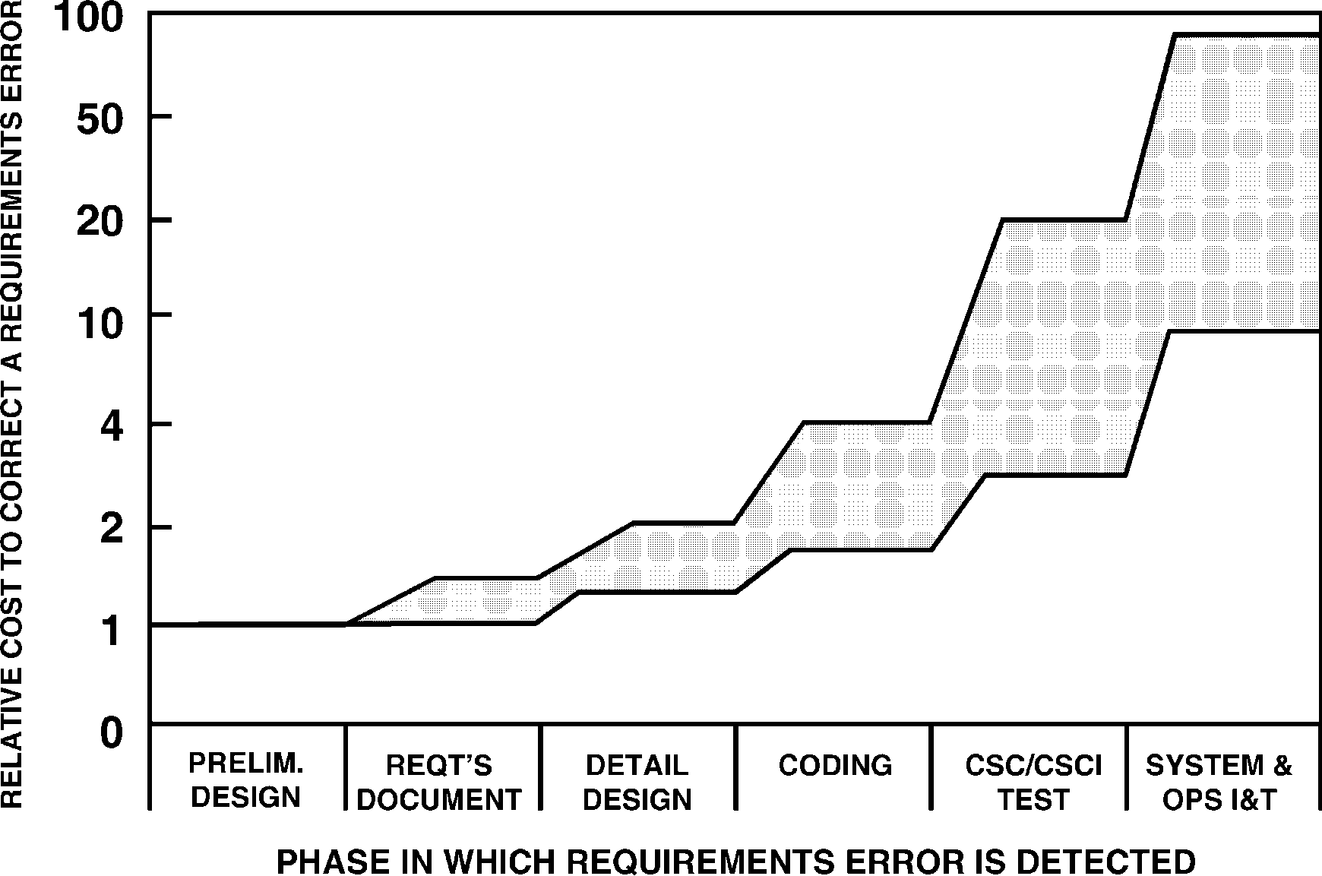
Relative Penalty of Error Correction
Figure 1.2:
Relative cost vs. phase
CSC: computer system component
CSCI: computer system configuration item
Notes:
This slide summarizes the observations from many software projects, as shown in Figure 1.3. We plot the relative cost of correcting a requirement error in various software engineering phases. It can be seen that the earlier a bug is found, the less it will cost to correct it.
Note that CSC stands for computer system component, and CSCI stands for computer system configuration item. They are all related to the idea of “modules” we mentioned earlier.

Slide 12
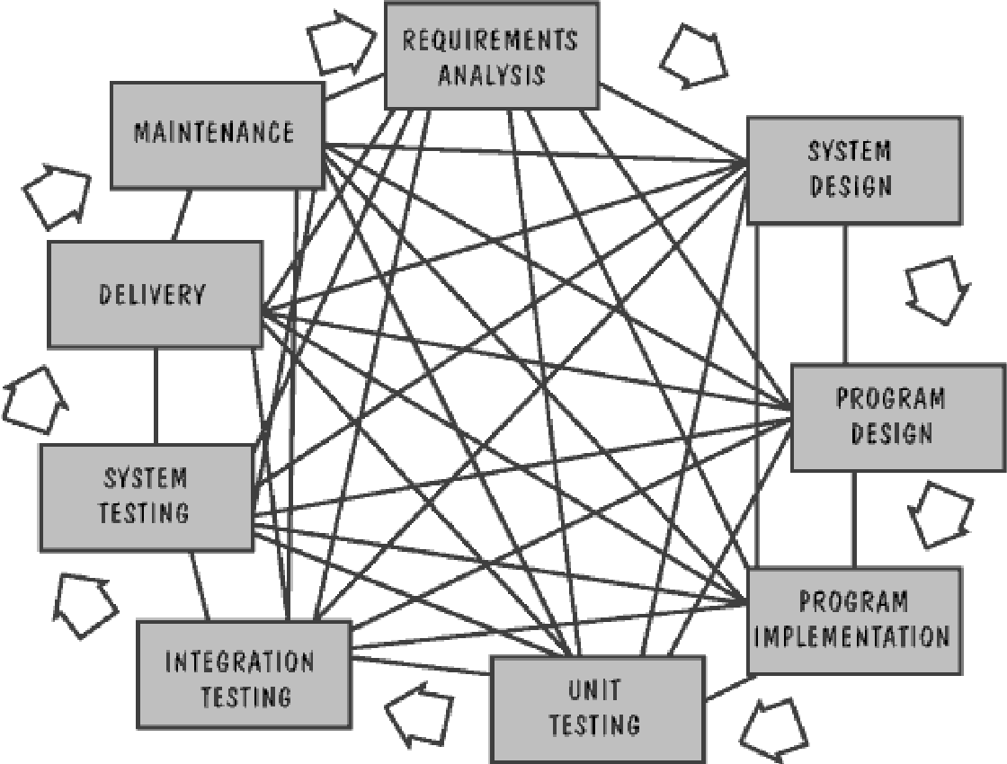
Possible Software Development Paths
Figure 1.3:
Many possible paths
to develop software
Notes:
There are many possible paths to develop software. However, if not well controlled, the development process can become chaotic.

Slide 13
Well-Engineered Software
The software should be efficient
The software should be reliable
The software should be maintainable
The software should offer an appropriate user interface
The software should be measurable for trade-off study
Notes:
A well-engineered software process should be efficient, reliable, maintainable, and offer an appropriate user interface. It should also be measurable for trade-off study.

Slide 14
Typical Trade-Off Study
Cost
“The law of
________________”
Figure 1.4:
Tradeoff between cost
and quality
… 0.9 0.99 0.999 0.9999 1.0
90% 99% 99.9% 99.99% (100%)
Efficiency or Reliability
(log scale)
Notes:
A typical example of trade-off study may involve depicting the relationship of cost and software quality, as shown in Figure 1.4. It is often plotted in log scale.
To obtain a 90% efficiency or reliability, you may need only 10% of cost. But in order to obtain another 10% efficiency and reliability, it may cost 90% of money and time. Note as a quality measure, efficiency or reliability cannot go beyond 100%.
This is called the law of diminishing returns.

Slide 15
Topic 1 Conclusion
We defined what software engineering is.
We explained why software engineering is needed.
We described a fundamental software life cycle, which is the traditional waterfall model.
We depicted a well engineered software.

